Slide 1
Chapter 7
Functions of Random Variables (Optional)

Slide 2
Section 7.1
Introduction

Slide 3
Section 7.2
Transformation of Variables

Slide 4
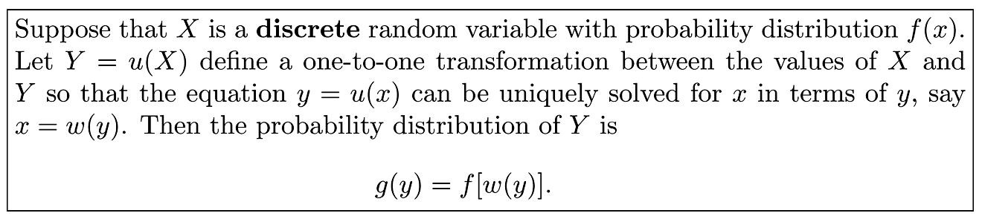
Theorem 7.1

Slide 5
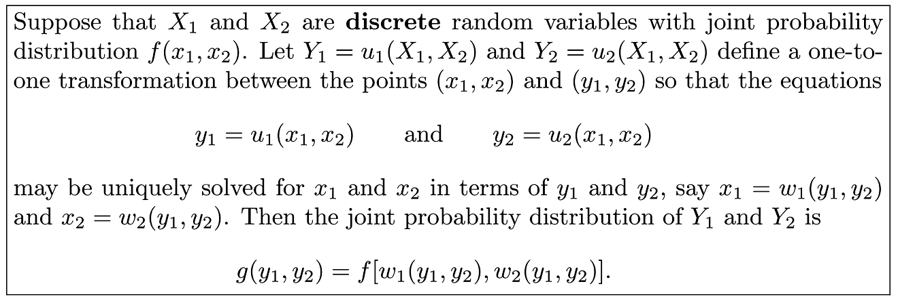
Theorem 7.2

Slide 6
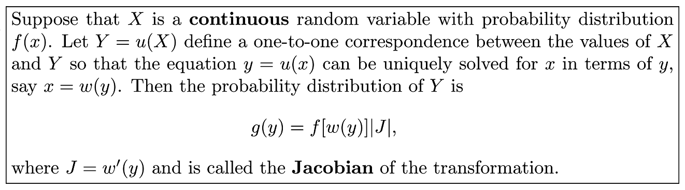
Theorem 7.3

Slide 7
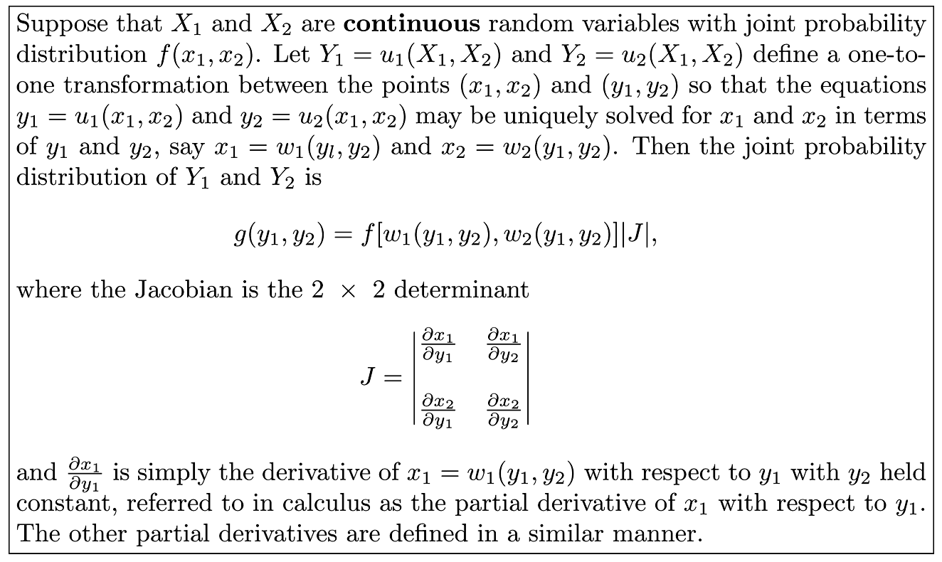
Theorem 7.4

Slide 8
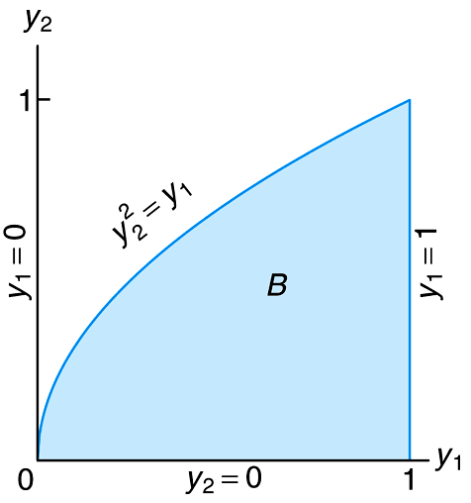
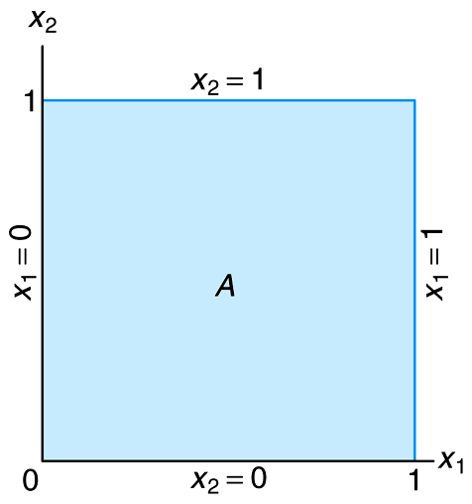
Figure 7.1 Mapping set A into set B

Slide 9
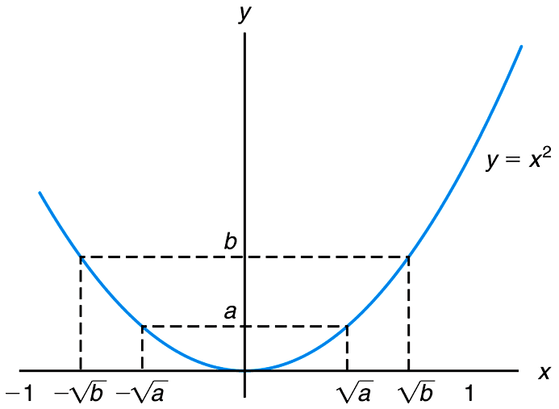
Figure 7.2 Decreasing and increasing function

Slide 10
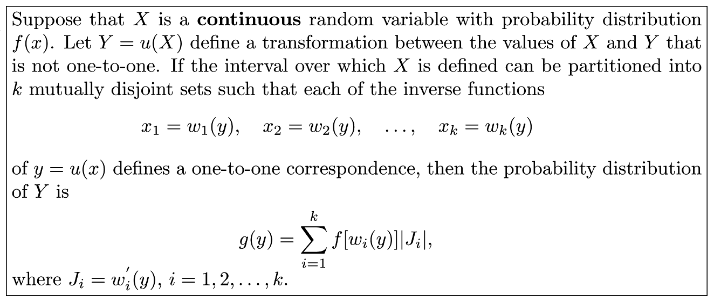
Theorem 7.5

Slide 11
Section 7.3
Moments and Moment-Generating Functions

Slide 12
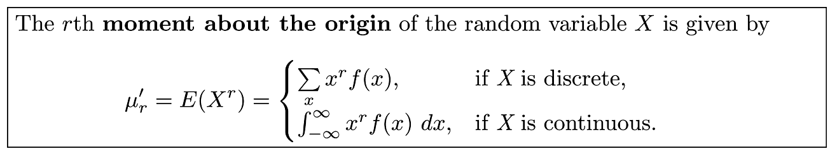
Definition 7.1

Slide 13
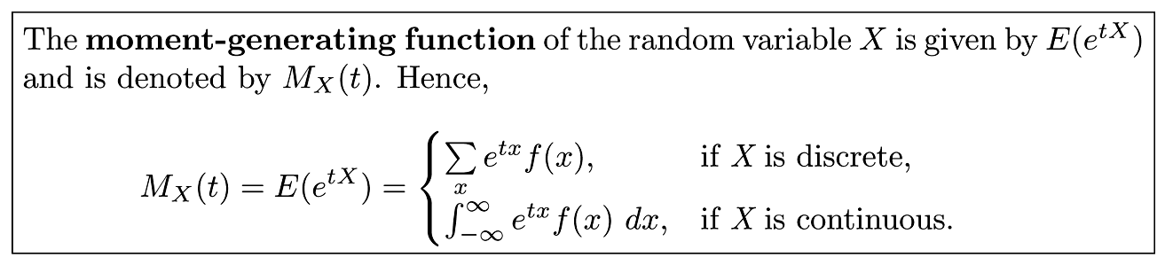
Definition 7.2

Slide 14
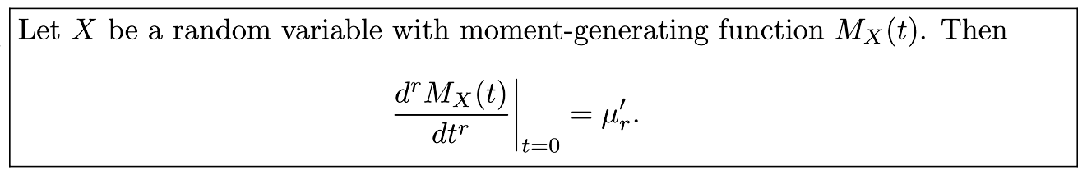
Theorem 7.6

Slide 15
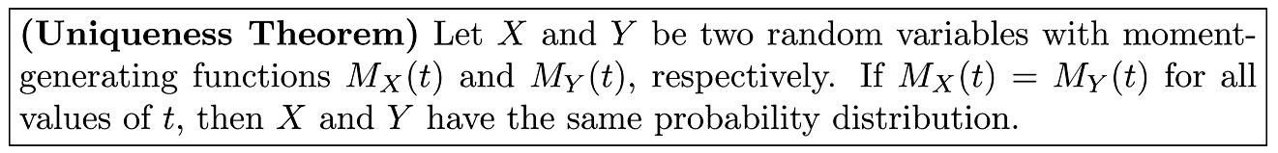
Theorem 7.7

Slide 16
Theorem 7.8

Slide 17
Theorem 7.9

Slide 18
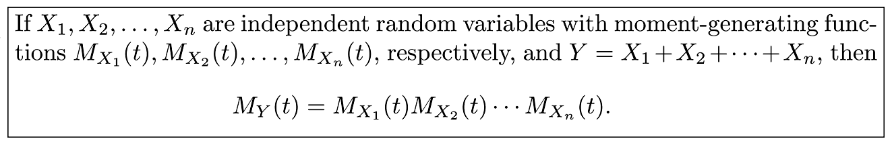
Theorem 7.10

Slide 19
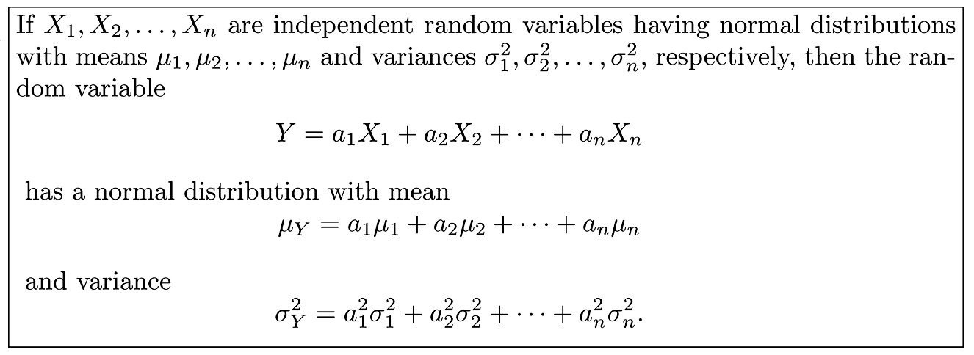
Theorem 7.11

Slide 20
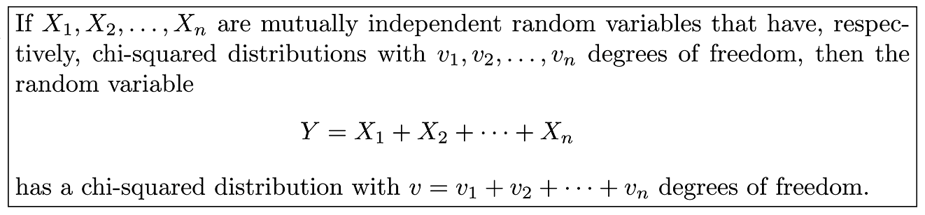
Theorem 7.12

Slide 21
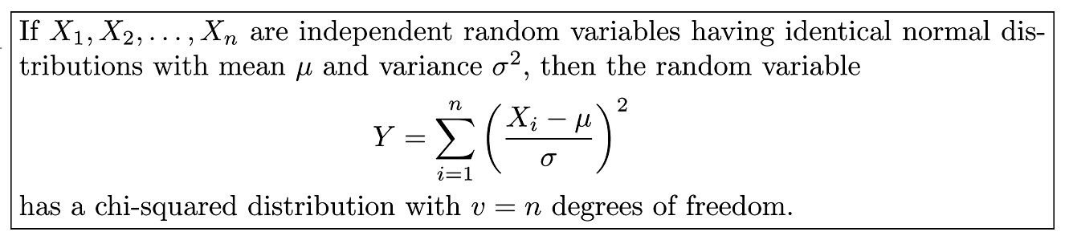
Corollary 7.1

Slide 22
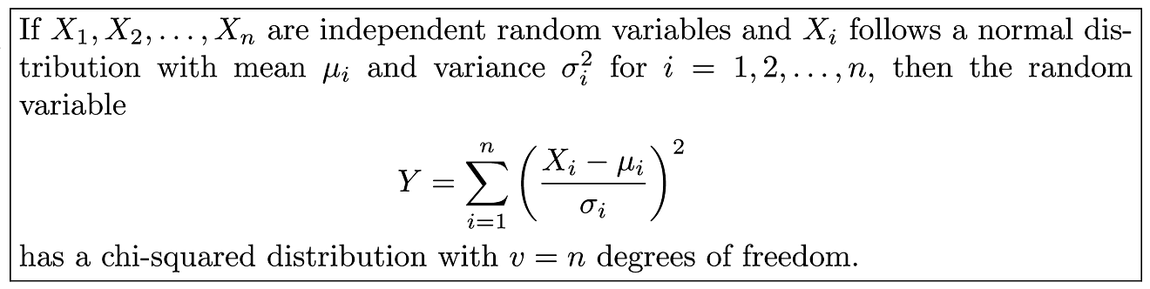
Corollary 7.2

